Slide 1
Slice it

Slide 2
NOTIA 4
Smart Operations
Slice it

Slide 3
Slice it

Slide 4
NOTIA 4
Live Disc Bootup
Slice it

Slide 5
Notia
Sat 9:29 PM
Welcome to Setup
Required fonts have not been installed; Notia will use Calibri
Welcome to Notia Enterprise! This setup will guide you through installation and setup.
Some settings have been pre-configured by your manufacturer or IT Administrator.
If you don’t have an IT Administrator, your manufacturer has not confirmed to set any Notia settings, or if your IT Administrator allows for a fresh installation, please turn off the system and use another setup CD/DVD/USB.
If you are here for something different, you may click on the Notia icon at any time before you begin installation and at any time the system is not counting down or loading.
Begin

Slide 6
Notia
Sat 9:29 PM
License Agreement
Required fonts have not been installed; Notia will use Calibri
Welcome to Notia Enterprise! This setup will guide you through installation and setup.
Some settings have been pre-configured by your manufacturer or IT Administrator.
If you don’t have an IT Administrator, your manufacturer has not confirmed to set any Notia settings, or if your IT Administrator allows for a fresh installation, please turn off the system and use another setup CD/DVD/USB.
I understand, continue.
I do not agree, turn off this PC

Slide 7
Notia
Sat 9:29 PM

Slide 8
Notia
Sat 9:29 PM
Partition Setup
We need to setup your partition. Thankfully, we have a recommended partition setup for you. This is the setup.
Drive C: - Allocated 425 GB
Next

Slide 9
Notia
Sat 9:29 PM

Slide 10
Notia
Sat 9:29 PM
Installation Time
That’s all we need from you for now. The system will reboot in 5 seconds to start the installation.

Slide 11
NOTIA 4
Rebooting…
Slice it

Slide 12
Slice it

Slide 13
NOTIA 4
Smart Operations
Slice it

Slide 14
Slice it

Slide 15
NOTIA 4
Live Disc Bootup
Slice it

Slide 16
Sun 12:16 PM

Slide 17
Sun 12:16 PM
Notia Installer
Unpacking files…

Slide 18
Sun 12:16 PM
Notia Installer
Installing system…

Slide 19
Sun 12:16 PM
Notia Installer
Installing fonts…

Slide 20
Sun 12:16 PM
Notia Installer
Installing drivers…

Slide 21
Sun 12:16 PM
Notia Installer
Installing apps…

Slide 22
Sun 12:16 PM
Notia Installer
Installing wallpapers…

Slide 23
Sun 12:16 PM
Almost done…
We are finding the best settings for your system…

Slide 24

Sun 12:16 PM
Notia Installer
Applying changes…

Slide 25
Sun 12:16 PM
Notia Installer
The system will now reboot to complete the installation.

Slide 26
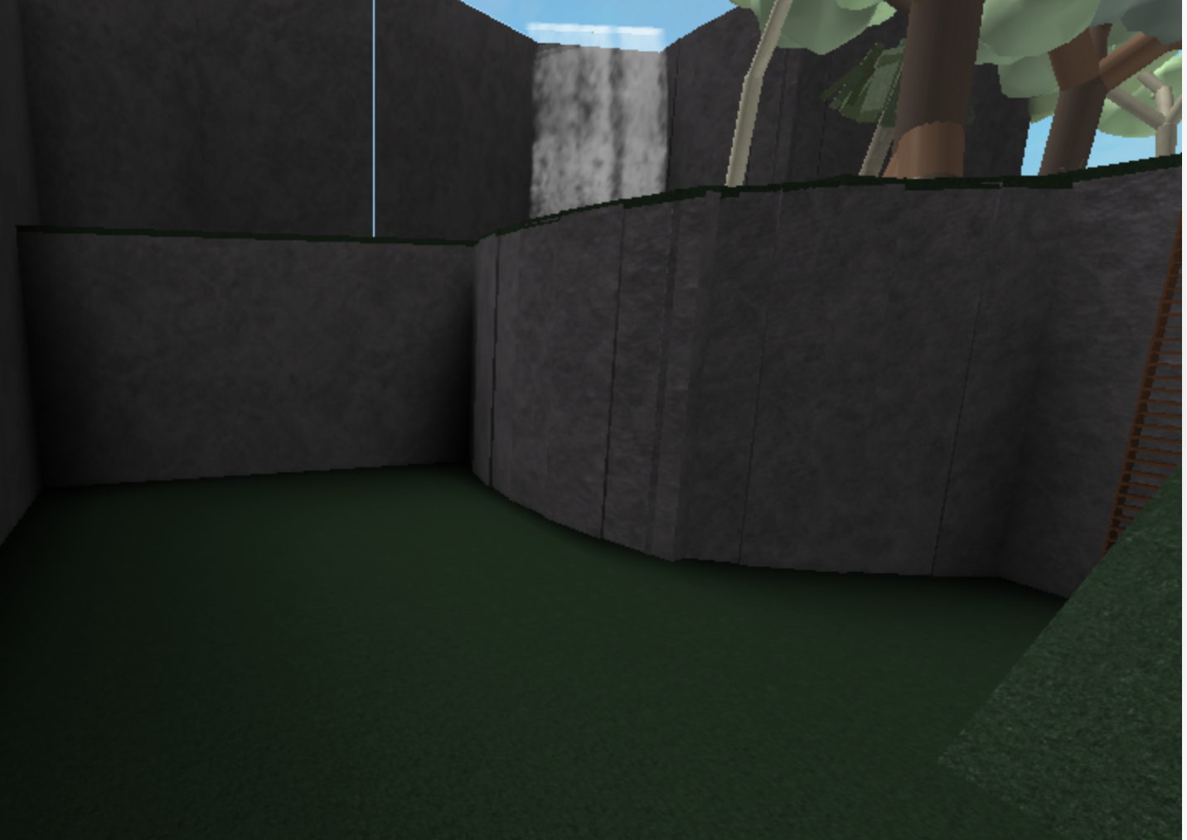
NOTIA 4
Rebooting…
Slice it

Slide 27
Slice it

Slide 28
NOTIA 4
Smart Operations
Slice it

Slide 29

Sun 12:16 PM

Slide 30
Notia
Sun 12:37 PM
Shall we continue?
Welcome back!
Next

Slide 31
Notia
Sun 12:37 PM
Notia
Now, we just need to setup a couple more things.
Next

Slide 32
Notia
Sun 12:37 PM
Notia
Maybe not, it says here that your system is preconfigured. Let’s turn off this system. If you want to access advanced options, click anywhere BUT the Turn Off button.
Turn Off

Slide 33
Notia
Sat 9:29 PM
Advanced Options
To use advanced options, you must restart your computer to installation media.
Welcome to Advanced Options!
You may access recovery settings such as reinstalling the system, using Disk Utility, debugging crashes, encrypting drives, and setting a firmware password.
Restart

Slide 34
Slice it

Slide 35
NOTIA 4
Smart Operations
Slice it

Slide 36
Slice it

Slide 37
NOTIA 4
Live Disc Bootup
Slice it

Slide 38
Notia
Sat 9:29 PM
Advanced Options
Welcome to Advanced Options!
You may access recovery settings such as reinstalling the system, using Disk Utility, debugging crashes, encrypting drives, and setting a firmware password.
Begin

Slide 39
Notia
Sat 9:29 PM

Slide 40
Notia
Reinstall
Firmware
Safe Mode
Sat 9:29 PM
Notia Recovery
You are now in Advanced Options. Click anywhere but the buttons in the topbar to access Disk Utility, then to cycle between Firmware and Safe Mode.

Slide 41
Notia
Reinstall
Firmware
Safe Mode
Sat 9:29 PM
Disk Utility
No problems have been found. All disks have been encrypted.

Slide 42
Notia
Reinstall
Firmware
Safe Mode
Sat 9:29 PM
Firmware
You are not using Notia Firmware, and as such you may not set a firmware password.

Slide 43
Notia Safe Mode
Sat 9:29 PM
Safe Mode
Welcome to Safe Mode! In Safe Mode, you may view stats that are not visible to normal developers. Click on the Notia Safe Mode button or the Notia icon to turn off the system.
WARNING! You have not finished setting up the system. We highly recommend to shut off the system.
Click anywhere but the buttons to continue.

Slide 44
kernel.panic({
“v.12”;
“PAGE_FAULT_MEMORY_LEAK”;
})
--[[
Click anywhere to reboot the system in to a prompt
to turn off the system.
]]--

Slide 45
Slice it

Slide 46
NOTIA 4
Smart Operations
Slice it

Slide 47
Slice it

Slide 48
NOTIA 4
Live Disc Bootup
Slice it

Slide 49
Notia
Sat 9:29 PM
Advanced Options
You don’t have the operating system installed.
Welcome to Advanced Options!
You may access recovery settings such as reinstalling the system, using Disk Utility, debugging crashes, encrypting drives, and setting a firmware password.
Turn off this PC

Slide 50
NOTIA 4
Shutting down…
Slice it

